Slide 1
CIT 260 Week Eight

Slide 2
Objectives
At the completion of this topic, students should be able to:
Design classes for use in a Java program
Explain the difference between a class and an object
Explain what class attributes and behaviors are
Explain the terms “encapsulation” and “data hiding”
Create accurate class diagrams using UML
Correctly declare instance member data in a class
Correctly write instance member methods in a class
Correctly create objects (instances of a class)
Correctly send messages to objects
Correctly write and use constructors
Explain the use of static data and static methods

Slide 3
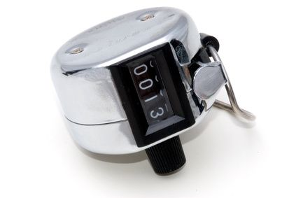
KEY CONCEPT
In object-oriented programming, an object
most often models things in the real world.
A counter

Slide 4
Real world objects have attributes
An object’s attributes describe its
“state of being”.
Depending upon the application, some attributes
are more important than others:
size
color
value

Slide 5
An object’s attributes describe its
“state of being”.
For our application, we are interested in
the value stored in the counter.
value

Slide 6
An object also has behaviors
Behaviors define how you interact with the object.
Add one to the counter
Subtract one from the counter
Get the current value
of the counter
Reset the counter
to zero

Slide 7
An Object’s Attributes and Behaviors Should Work Together
This is called cohesion.

Slide 8
This object has strong cohesion because
all of the operations work on the single
data value in the counter, its value.

Slide 9
A class is a blueprint that a program
uses when it creates an object.
A class reserves no space in memory.
When an object is created from the class
blueprint, memory is reserved to hold the
object’s attributes.
An object is also known as an instance of the class.
Each object has its own space for data.

Slide 10
The attributes of an object are stored in the
data fields (data members) defined in the class.
The behaviors of an object are defined by the
methods defined in the class.

Slide 11
A class is said to be an abstraction of the
real world object that it is modeling.

Slide 12
Encapsulation
Counter object
add( )
Calling method
Member methods are
declared as public.
We should not allow code
outside of the object to reach in and change the data directly. Instead, we call methods in the
object to do it for us.
theValue
Member data is declared
as private.
Public and private are called access modifiers.

Slide 13
We use a UML Class Diagram to document the
data and methods contained in our classes.

Slide 14
A UML class diagram is used
to describe a class in a very precise
way.
A class diagram is a rectangle.
At the top of the rectangle is the
class name. A line separates the
class name from the rest of the
diagram.
Counter
class Counter
{
}

Slide 15
Counter
Following the class name we write
the data members of the class. A
line separates the data members
from the rest of the diagram.
- counterValue: int
class Counter
{
private int counterValue;
}
access modifier:
+ public
- private
data member name
data type

Slide 16
+ add( ): void
Following the data members, we
write the member methods.
Counter
counterValue: int
class Counter
{
private int counterValue;
public void add( ){ }
}
access modifier
+ public
- private
method name
return type
parameters

Slide 17
+ add( ): void
+ subtract: void
+ reset( ): void
+ getValue( ): int
Counter
Adding the remaining methods, we have:
counterValue: int
class Counter
{
private int counterValue;
public void add( ){ }
public void subtract( ) { }
public void reset( ) { }
public int getValue( ) { }
}

Slide 18
It is important that class diagrams be drawn
precisely and that they conform to the form
shown in these examples.
When you submit a class diagram as part of an
assignment, the preferred file format is PDF.

Slide 19
The ability to create good models of the real
world objects in our programs takes a lot of
practice and a long time to develop.

Slide 20
Practice

Slide 21
Design a class that represents “Integer” objects.
What are the data members of the class?

Slide 22
Design a class that represents “Integer” objects.
Suppose we want methods to:
Set the integer value in the object
Retrieve the integer value in the object
Retrieve the reciprocal of the value in the object

Slide 23
Create the UML class diagram
Integer

Slide 24
Design a class that represents “StudentInfo” objects.
You could use an object of this class to hold the
student information you print out at the beginning
of each of your programming projects.
What are the data members of the class?

Slide 25
Design a class that represents “StudentInfo” objects.
Suppose we want methods to:
Set the name, course, and section values in the object
Retrieve the name, course and section values from the object
Output the data stored in the student object

Slide 26
Create the UML class diagram
StudentInfo

Slide 27
Design a class that represents a car.
The important attributes of a car for this
application are:
How much gas it has in its tank
What kind of mileage (mpg) it gets.
We need member methods (behaviors) that provide the following:
Create a car object with a given mpg rating
Add n gallons of gas to the tank
Drive the car y miles
Report on how much gas is in the tank

Slide 28
Create the UML class diagram
Car

Slide 29
Design a class that represents a student. The
important properties of a student for this application
are the student’s name, and the scores for two quizzes
(10 pts possible on each) and two exams (100 pts possible
on each).
We need member methods that:
Create a student object
Set all scores to zero
Save the score for quiz 1
Save the score for quiz 2
Save the score for exam 1
Save the score for exam 2
Calculates the student’s percent
of points possible

Slide 30
Create the UML class diagram
Student

Slide 31
Writing the code to define a class

Slide 32
Book
title: string
price: double
Consider this UML class
diagram for a “book” class.
+ Book( )
+ Book(:string, :double)
+ getTitle( ): string
+ setTitle(:string): void
+ getPrice( ): double
+ setPrice(:double): void

Slide 33
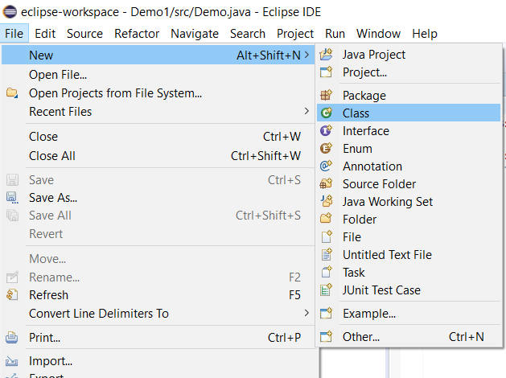
ADDING A CLASS TO AN EXISTING PROJECT
(1) Click on New > Class

Slide 34
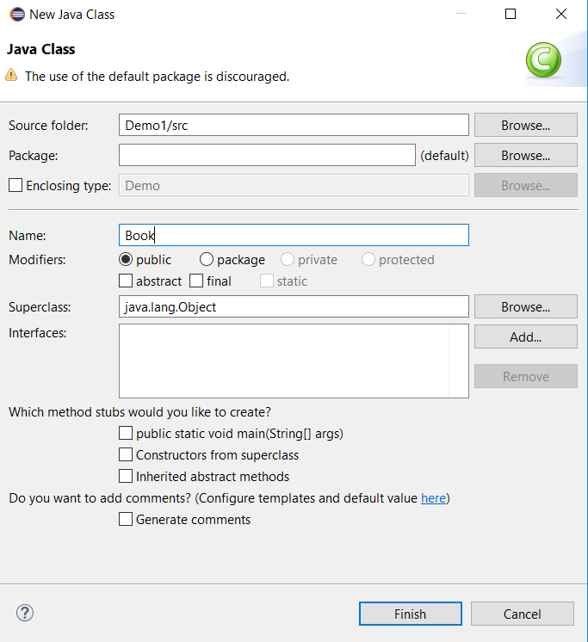
(2) When the new Class dialog opens,
type the name of your class.
None of these boxes
need to be checked.
(3) Click on Finish

Slide 35
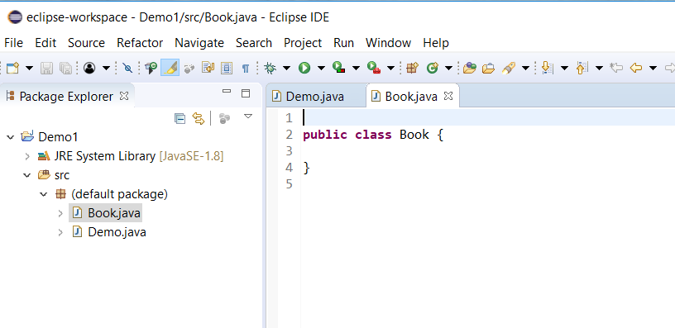
Click on the tabs to move from
one source code file to the other.
The file for your new class
opens in the source code
editor.

Slide 36
To start a class definition
The keyword “class”
The class name we have chosen
class Book {
}
A set of curly braces:
The body of the class
will go in between them.

Slide 37
DECLARING MEMBER DATA
Member data is “private”.
class Book {
private string title;
}
data type
variable name
Indent each line inside the block.

Slide 38
DECLARING MEMBER DATA
class Book {
private string title;
}
We call data members of a class Instance Data
because each instance (object) of the class
will contain its own unique copy of this data.

Slide 39
DECLARING MEMBER DATA
class Book {
private string title;
private double price;
}

Slide 40
DECLARING MEMBER METHODS
class Book {
private string title;
private double price;
public void setTitle( string t)
{
}
}
Member methods are
usually public.
parameters
method name
return type

Slide 41
DECLARING MEMBER METHODS
class Book {
private string title;
private double price;
public void setTitle( string t) {
. . .
}
}
The body of
the method goes
between these
curly braces.

Slide 42
“Getter” Methods
They are usually named
“get” plus the name of the
instance variable they
will return the value of.
class Book {
. . .
public string getTitle( ) {
return title;
}
}
Getters take no
parameters.
Getters always
return something.

Slide 43
“Setter” Methods
They are usually named
“set” plus the name of the
instance variable they
will return the value of.
class Book {
. . .
public void setTitle(String t ) {
title = t;
}
}
Setters never
return anything.
Setters always take
a parameter.
The value of the parameter is
stored in an instance variable.

Slide 44
Don’t forget the method prologue:
/**
* the setTitle method
* Purpose” to set the title of a book object
* @param the title to set, as a string
* @return void
*/
public void setTitle(String t ) {
title = t;
}

Slide 45
Creating Objects

Slide 46

Class definition
Class Book
{
private string title;
private double price;
. . .
}
Book nextBook = new Book( );
This statement takes the Book class
definition and uses it to create
the object “nextBook”.
When creating the object, storage
is allocated for each of the data
members defined in the class.
Each data member is initialized to
a standard default value.
Note that nextBook is a reference
variable. It “points” to the object.
title
price
nextBook

Slide 47
Sending Messages to Objects

Slide 48
Parameters
nextBook.setTitle(“Java for Everyone” );
.
message
object
name
method
name
title
price
nextBook

Slide 49
nextBook.setTitle(“Java for Everyone”);
This statement sends the setTitle
message to the object named nextBook.
As the method executes, the value of
the parameter “t” is stored in the
instance variable title in the object
named nextBook.
message
title
price
void setTitle(string t)
{
title = t;
}
nextBook

Slide 50
Constructors
Creating objects with uninitialized member data can be dangerous.
If you try to use an uninitialized instance variable in a program,
Eclipse will tell you that you have an error.
Constructors provide us with a handy way to initialize member data
when an object is created.

Slide 51
Important Note: Constructors don’t create
objects! They are used to initialize data
in an object.

Slide 52
Constructor Definition
A constructor is a member method of a class, but it has
two unique qualities:
It must have the same name as the class
It has no return type (not even void)

Slide 53
class Book {
private string title;
private double price;
public Book( ) {
. . .
}
}
This is the constructor for the Book class.
Notice that it has the same name as the class
and has no return type.

Slide 54
In a default (non-parameterized)
constructor set values to
reasonable default values.
class Book {
private string title;
private double price;
public Book( ) {
title = “none”;
price = 0.0;
rating = 0;
}
}

Slide 55
METHOD OVERLOADING
We say that a method is overloaded when we have
two or more methods with the same name, but with
different signatures.

Slide 56
class Book {
private string title;
private double price;
public Book( ) {
title = “none”;
price = 0;0;
}
public Book(string t, double pr ) {
title = t;
price = pr;
}
}
Constructors can be overloaded.

Slide 57
class Book {
private string title;
private double price;
public Book( ) {
title = “none”;
price = 0;0;
}
public Book(string t, double pr )
{
title = t;
price = pr;
}
}
This constructor stores values
that are passed as parameters.

Slide 58
You do not have to write a constructor if
you are happy with the default values that
the compiler uses. The compiler builds a
default constructor for you.

Slide 59
However, if you write a parameterized constructor,
you should also write your own default constructor.
the compiler won’t create one for you.

Slide 60
Static Data Members
Normally, each object of a class keeps its own copy of the
data members defined in the class.
class Book
{
private double price;
…
}
book2
price
$85.00
book3
price
$64.50
book1
price
$75.95

Slide 61
Static Data Members
When a data member is declared as static, there is only
one copy of the variable, and it is shared by all instances
of the class.
class Book
{
private static double price;
…
}
book2
price
price
$64.50
book3
price
book1
price

Slide 62
Static Member Methods
Member methods of a class can also be declared as static.
A static method can be invoked without an object
of the class having ever been created.
As a result, static methods cannot do anything that depends
on there being a calling object. In particular, a static method
cannot use non-static member data.
Static member functions are invoked using the class name:
Book.setPrice (54.00);

Slide 63
Now you can see why the method main( )
is declared as static. We can invoke main( )
without ever creating an object.

Slide 64
Scope of Variables
The scope of instance and static variables is the entire class. They can be declared anywhere inside a class.
The scope of a local variable starts from its declaration and continues to the end of the block that contains the variable. A local variable must be initialized explicitly before it can be used.

Slide 65
Practice
Write a program that defines a Book class as described in this
set of slides. In the main( ) method of your program, create a
Book object and use the setters in the Book class to store some
values in the object. Then use the getters to get and display these
values.

